Slide 1

If-Else Decision Statements
if statement is used to make a decision based on a condition.
Condition can be an expression (examples: if(x + y) or if(num1>5)) of a direct value (example: if(5))
If the expression produces zero, or direct value is zero, the condition becomes FALSE. For all other values, the condition is TRUE

Slide 2
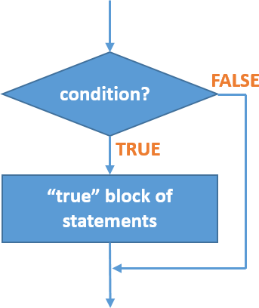
If Statement Flowchart
Example

Slide 3
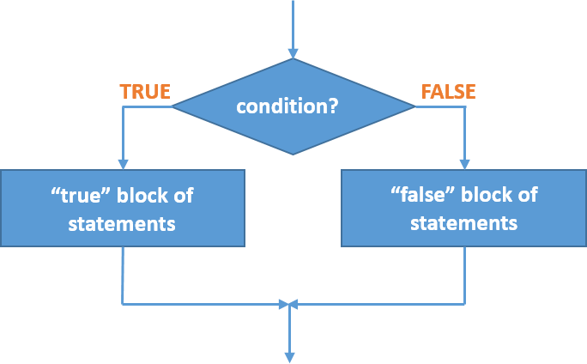
If-Else Statement Flowchart
Example

Slide 4
If-Else Statements Syntax
If Statement: if (condition) {
// body statements…
}
If-Else Statement: if (condition) {
// body statements…
}
else {
// body statements…
}

Slide 5
Else-If Statements Syntax
Else If Statement: if (condition) {
// body statements…
}
else if (condition) {
// body statements…
}
else {
// body statements…
}

